Slide 1
Design Data Model (Ecommerce sample)
Customers
Id
Email
Name
Address
Favorite Products
Products
Id
Name
About
Price
Brand
Brand Description
Category
Orders
Product
Customer
Warranty
Purchase Date

Slide 2
DB Model Concept
3 Level of DB model
Conceptual
Logical
Physical
Feature | Conceptual | Logical | Physical
Entity Name | Y | Y
Entity Relationship | Y | Y
Attributes |  | Y
PK |  | Y | Y
FK |  | Y | Y
Table Names |  |  | Y
Column names |  |  | Y
Column data type |  |  | Y

Slide 3
Normalization
Normalization is database design technique which organizes tables in a manner that reduces redundancy and dependency of data
Redundant Data = Useless Data = Same Data stored in more than one place

Slide 4
Problems without Normalization
Updation Anamoly
Insertion Anamoly
Deletion Anamoly

Slide 5
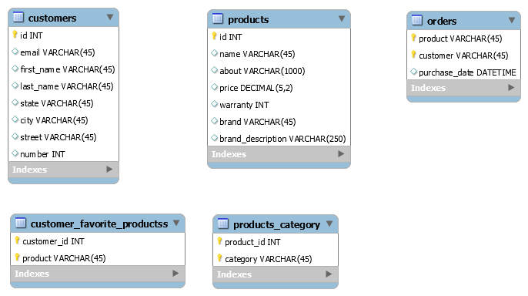
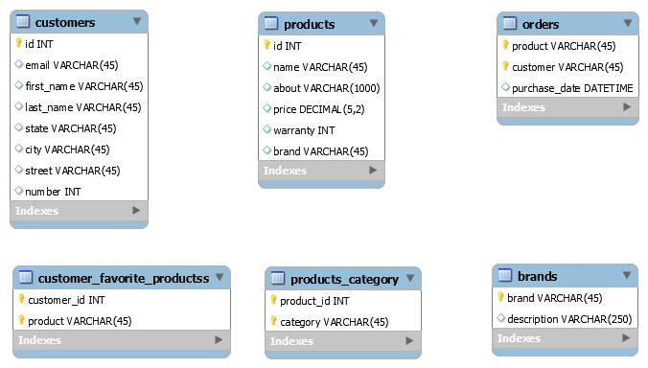
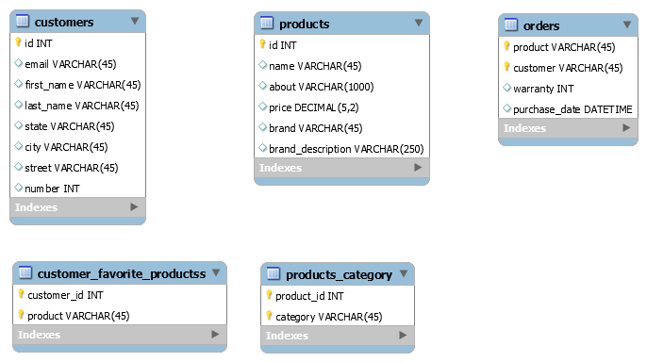
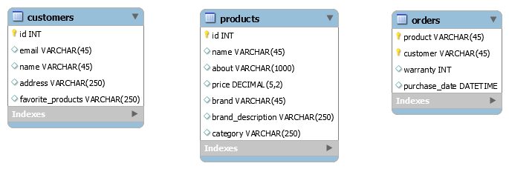
Schema

Slide 6
1NF
A table in 1NF if and only if the domain of each attribute contain only atomic value and value of each attribute contains only a single value from that domain.
1NF rule
Each table cell should contain single(Atomic) value
Each record needs to be unique

Slide 7
1NF

Slide 8
2NF
A table in 2NF if it is in 1NF and no non-prime attributes is dependent on any proper subset of any candidate key of the table. A non-prime attribute of a table is an attribute that is not a part of any candidate (composite primary) key
2NF rule
Table should be in 1NF
Every non-key attribute of the table is dependent on the whole composite primary key
Customer | Product | Warrenty | Purchase
Mary | iPhone14 | 3 year | 01.01.23

Slide 9
2NF

Slide 10
3NF
A table in 3NF if and only if both of following conditions hold
Table is in 2NF
Every non-prime attribute of table is non-transitively dependent on every key of Table
3NF applies that every non-prime attribute of table must be dependent on primary key

Slide 11
3NF

Slide 12
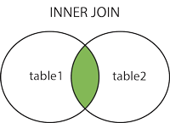
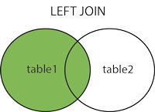
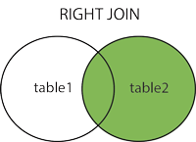
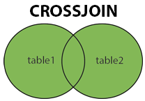
Supported Types of Joins in MySQL
INNER JOIN: Returns records that have matching values in both tables
LEFT JOIN: Returns all records from the left table, and the matched records from the right table
RIGHT JOIN: Returns all records from the right table, and the matched records from the left table
CROSS JOIN: Returns all records from both tables

Slide 13
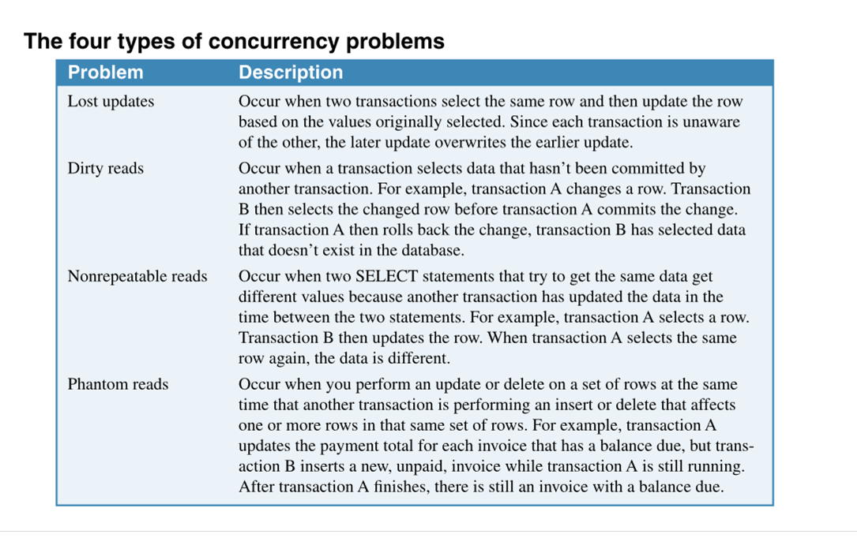

Slide 14
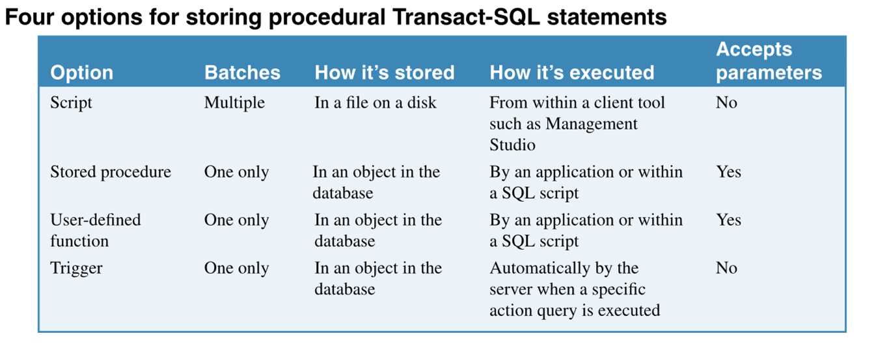

Slide 15
